Slide 1
DEPARTMENT OF ELECTRONICS AND COMMUNICATION ENGINEERING
PUNJABI UNIVERSITY, PATIALA
AI-GESTURE CONTROL
Himanshu Saini
B.Tech ECE 3rd year (6th Sem.)
12302052

Slide 2
Introduction
AI Gesture Control System allows users to control devices using hand gestures.
It uses computer vision and machine learning techniques to recognize gestures.
This system reduces physical contact with devices and enhances human–machine interaction.

Slide 3
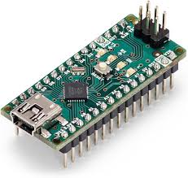
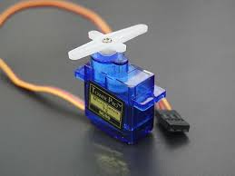
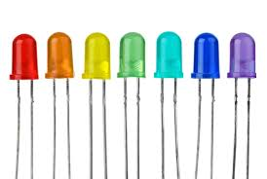
HARDWARE USED:
HARDWARE USED
Camera Module / Webcam: Captures real-time hand gesture images for processing.
Raspberry Pi / Arduino: Processes control signals and interfaces AI output with hardware.
Servo Motor: Provides precise angular movement based on recognized gestures.
LED: Indicates system response or gesture execution status.
Power Supply: Provides required electrical power to all components.
Connecting Wires: Enables electrical connections between hardware components.

Slide 4



SOFTWARE USED:
SOFTWARE USED
Python: Core programming language for AI and gesture recognition logic.
OpenCV: Processes images and detects hand movements from camera input.
MediaPipe / TensorFlow: Identifies and classifies hand gestures using AI models.
Arduino IDE: Programs the Arduino board to control hardware components.
Raspberry Pi OS / Windows: Operating system for running AI and control programs.

Slide 5
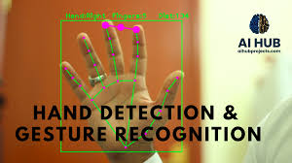
BRIEF DESCRIPTION
The camera captures hand gestures and sends image data to the AI processing unit.
The AI model detects and classifies gestures.
Recognized gestures are converted into control commands.
These commands control motors, LEDs, or other devices through a microcontroller.

Slide 6
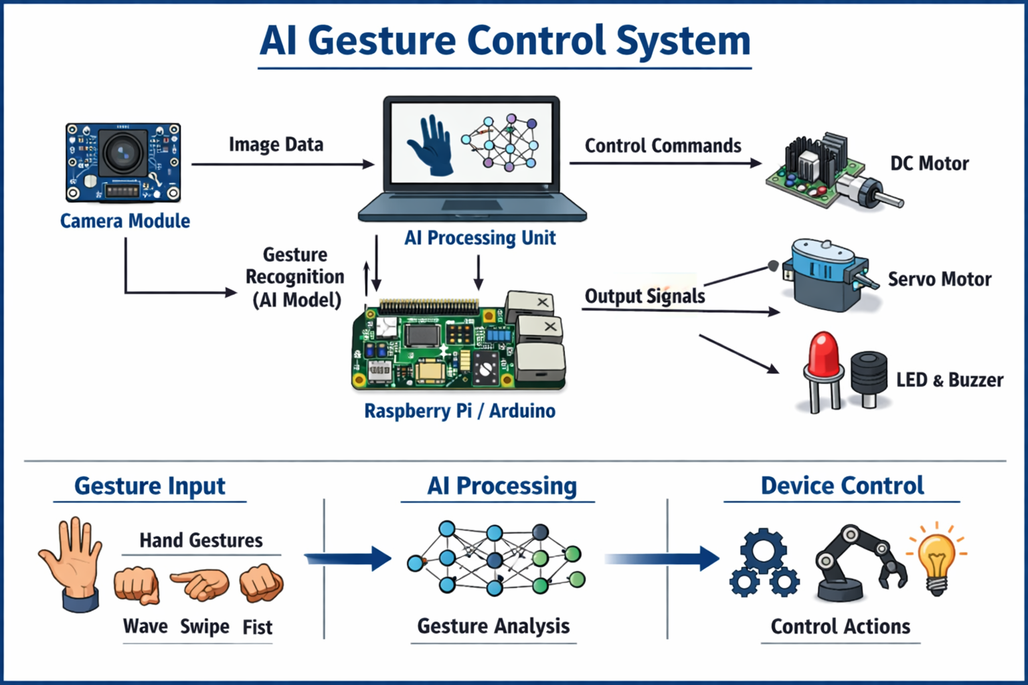
SCHEMATIC DIAGRAM

Slide 7
ADVANTAGES:
Touchless Operation:
The system works without physical contact, making it hygienic and suitable for public and medical environments.
Natural Human Interaction:
Hand gestures are intuitive, allowing users to control devices easily without special training.
Improves Accessibility:
Helpful for elderly and physically challenged users who may find traditional input devices difficult.
Reduces Mechanical Wear:
Eliminates buttons, switches, and keyboards, reducing maintenance and mechanical failure.
Wide Application Scope:
Can be used in home automation, robotics, healthcare, gaming, and industrial systems.
Flexible and Scalable:
New gestures and devices can be added by updating the software.
Enhanced User Experience:
Provides a modern, smart, and interactive way of controlling electronic devices.

Slide 8
DISADVANTAGES:
Lighting Dependency:
Performance reduces in poor or uneven lighting conditions.
High Processing Requirement:
Real-time gesture recognition needs powerful processors and increases system cost.
Limited Gesture Accuracy:
Similar gestures may cause misinterpretation or incorrect actions.
Camera Dependency:
System fails if the camera is blocked or malfunctioning.
Latency Issues:
Slight delays may occur due to image processing and AI computation.

Slide 9
APPLICATIONS:
Home Automation:
Used to control lights, fans, TV, and other appliances using hand gestures.
Robotics Control:
Enables robots to move, pick objects, or perform tasks based on human gestures.
Healthcare Systems:
Allows touchless operation of medical equipment, reducing the risk of infection.
Smart Wheelchairs:
Helps physically challenged users control wheelchair movement through gestures.
Gaming and Virtual Reality:
Provides immersive control in games and VR environments without controllers.
Industrial Automation:
Used to control machines in hazardous environments where physical contact is unsafe.
Presentation and Media Control:
Enables gesture-based control of slides, videos, and multimedia systems.
Automotive Systems:
Used for controlling infotainment and dashboard functions without distraction.
Public Touchless Systems:
Applied in kiosks, elevators, and ATMs to minimize physical contact.

Slide 10
CONCLUSION:
AI Gesture Control System demonstrates the power of AI in human–machine interaction.
It provides a modern and intuitive way to control devices.
With improvements in AI models and hardware, gesture-based systems have a strong future.

Slide 11
THANK YOU

